Slide 1
Discrete Mathematics
South China University of Technology

Slide 2
Chapter 2. Logic and Proof, Sets, and Function
Sets
Section 2.1-2.2

Slide 3
Contents
1
Introduction of Sets
2
Power Sets
3
Set Operations
4
Set Identities, Generalized and Intersections
5
Computer Representation of Sets

Slide 4
Introduction of Sets

Slide 5
Introduction to Set Theory (§1.6)
A set is an unordered collection of objects.
Sets are ubiquitous无所不在的in computer software systems.
All of mathematics can be defined in terms of some form of set theory.

Slide 6
The objects in a set are also called the element, or members, of the set. A set is said to contain its element.
Example 1: V={a,e,I,o,u}
Example 2: O={1,3,5,7,9}
Example 3: {a,2,Fred,New,Jersey}
Example 4:
N = {0, 1, 2, …} The Natural numbers. Z = {…, -2, -1, 0, 1, 2, …} The integers.
Q={ p / q | p ∈ Z, q ∈ Z, q≠0} is the set of rational number.

Slide 7
Two sets are equal if and only if they have the same elements.
{1, 3, 5} and {3, 5, 1} are equal.
{1, 3, 3, 3, 5, 5, 5, 5} is the same as {1, 3, 5}
No matter what objects a, b, and c denote, {a, b, c} = {a, c, b} = {b, a, c} = …
Multiple listings make no difference:
{a, a, c, c, c, c}={a,c}.

Slide 8
The Empty Set
We have seen that there exists exactly one empty set, so we can give it a name:
∅ (“the empty set”) is the unique set that contains no elements whatsoever.
∅ = {} = {x|x≠x} = ... = {x|False}
Any set containing exactly one element is called a singleton set(单元素集合)

Slide 9
Subset and Superset Relations
S⊆T (“S is a subset of T”) means that every element of S is also an element of T.
S⊆T :≡_{def} ∀x (x∈S → x∈T)
What do you think about these?
∅⊆S ?
S⊆S ?
Notes:
Note also that FORALL x P(x)->Q(x) can also be understood as meaning “{x|P(x)} is a subset of {x|Q{x}}”. This can help you understand the meaning of implication. For example, if I say, “if a student has a drivers license, then he is over 16,” this is the same as saying “the set of students with drivers licenses is a subset of the set of students who are over 16”, or “every student with a drivers license is over 16.” If no students in the universe of discourse have drivers licenses, then the antecedent is always false, or in other words the set of students with drivers licenses is just the empty set, which is of course a member of every set, and so the statement is vacuously true. Alternatively, if every student in the universe of discourse is over 16, then the consequent is always true, that is, the set of students who are over 16 is the entire universe of discourse, and so every set of students in the u.d. is necessarily a subset of the set of students who are over 16, and so the statement is trivially true. The statement is only false if there exists a student with a drivers license in the u.d. who is under 16 (perhaps the license is fake or from a foreign country), in which case, the set of students with drivers licenses is *not* a subset of the under-16 students.

Slide 10
Subset and Superset Relations
More notation:
S⊇T (“S is a superset of T”) :≡_{def} T⊆S.
Note S=T ⇔ S⊆T∧ S⊇T.
:≡_{def} ¬(S⊆T), i.e.
∃x(x∈S ∧ x∉T)
Notes:
Note also that FORALL x P(x)->Q(x) can also be understood as meaning “{x|P(x)} is a subset of {x|Q{x}}”. This can help you understand the meaning of implication. For example, if I say, “if a student has a drivers license, then he is over 16,” this is the same as saying “the set of students with drivers licenses is a subset of the set of students who are over 16”, or “every student with a drivers license is over 16.” If no students in the universe of discourse have drivers licenses, then the antecedent is always false, or in other words the set of students with drivers licenses is just the empty set, which is of course a member of every set, and so the statement is vacuously true. Alternatively, if every student in the universe of discourse is over 16, then the consequent is always true, that is, the set of students who are over 16 is the entire universe of discourse, and so every set of students in the u.d. is necessarily a subset of the set of students who are over 16, and so the statement is trivially true. The statement is only false if there exists a student with a drivers license in the u.d. who is under 16 (perhaps the license is fake or from a foreign country), in which case, the set of students with drivers licenses is *not* a subset of the under-16 students.

Slide 11
Proper (Strict) Subsets & Supersets
S⊂T (“S is a proper subset of T”) means that S⊆T but .
Example:{1,2} ⊂ {1,2,3}
We have {1,2,3} ⊆ {1,2,3},
but not {1,2,3} ⊂ {1,2,3}
Notes:
Here the understanding is that the blue/green area is empty!

Slide 12
Sets Are Objects, Too!
The objects that are elements of a set may themselves be sets.
E.g. Let S={x | x ⊆ {1,2,3}}, then
S={∅, {1}, {2}, {3}, {1,2}, {1,3}, {2,3}, {1,2,3}}
Note that 1 ≠ {1} ≠ {{1}}
Notes:
In general, any kind of object or structure, whether simple or complex, can be a member of a set. In particular, sets themselves (being structures) can be members of sets.
If you don’t understand the distinction between 1, {1}, {{1}}, you’ll make endless silly mistakes. 1 is a number, the number one. {1} is NOT A NUMBER AT ALL! It is a COMPLETELY DIFFERENT TYPE OF OBJECT! Namely, it is a set. What kind of set? It is a singleton set, by which we mean a set that contains exactly one element. In this case, its element happens to be the number 1. Now, what is {{1}}? It is also a set, and also a singleton set, but it is a COMPLETELY DIFFERENT TYPE of singleton set. To see this, notice that {1} is a set of numbers, whereas {{1}} is not a set of numbers at all! It is a SET OF SETS. Its single element is not a number at all, but is a SET. Namely, the set {1}. In other words, {{1}} is the singleton set whose member is the singleton set whose member is 1. Whereas, {1} is just the singleton set whose member is 1. And, 1 is just 1. All of these are distinct objects and you’ve got to learn to keep them separate! Otherwise, you’ll never have a chance of understanding data types in programming languages. For example, in most languages, we can have an array of numbers, or an array of arrays of numbers, etc. These are all completely different types of objects and can never be compatible with each other.

Slide 13
Cardinality and Finiteness
|S| (read “the cardinality of S”)基数，大小 is a measure of how many different elements S has.
E.g., |∅|=0, |{1,2,3}| = 3, |{a,b}| = 2, |{{1,2,3},{4,5}}| = ____
If |S|∈N, then we say S is finite. Otherwise, we say S is infinite.
2

Slide 14
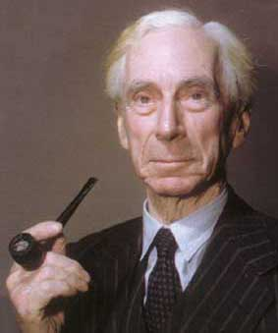
This version of Set Theory is inconsistent
Russell’s paradox: 罗素悖论
Consider the set that corresponds with the predicate x ∉ x :
S = {x | x∉x }.
Now ask: is S∈S?
Bertrand Russell 1872-1970
Notes:
Turn into exercise!
See note about ZF in the earlier slide near the start of this module.
Bertrand Russell was the guy who discovered this particular pathalogical example. The question of whether it is a member of itself is known as “Russell’s Paradox.”

Slide 15
Case 1. Yes, i.e., S∈S.
S∈S ⇒S ∈ {x | x∉x } ⇒ S ∉ S.
Case 2. No. , i.e., S ∉ S.
S ∉ S ⇒ S ∈ {x | x∉x } ⇒ S∈S.
Let P=(S∈S). We have proved:
P ⇔ ¬ P
We have two choices
P is both T and F.
P is undecidable (unprovable).

Slide 16
Computer Representation
of Sets

Slide 17
Representing Sets with Bit Strings
In this representation, the set operators “∪”, “∩”, “-” are implemented directly by bitwise OR, AND, NOT!
For example, {2,3,5,7} ∪ {1,3,4}
= 01101010 ∨ 10110000
= 11111010
Notes:
So, for example, on a 64-bit processor, using just a single machine-language instruction you can calculate the union or intersection of two sets out of a universe of discourse having up to 64 elements. This leads to an extremely fast way of doing complicated calculations on small sets. It is not a good method for large, sparsely populated sets, because searching the bit string to find which bits are “1” can take a long time.

Slide 18
Representing Sets with Bit Strings
Let T={x₁, x₂, … x_{n}} ，S⊆T . Represent S as a bit string b₁b₂…b_{n} where ∀i: b_{i}=1 ⇔ x_{i}∈S.
E.g. T={1,2,…,8}, S={2,3,5,7}.
b₁b₂…b₈ =01101010.
Notes:
So, for example, on a 64-bit processor, using just a single machine-language instruction you can calculate the union or intersection of two sets out of a universe of discourse having up to 64 elements. This leads to an extremely fast way of doing complicated calculations on small sets. It is not a good method for large, sparsely populated sets, because searching the bit string to find which bits are “1” can take a long time.

Slide 19
Power Sets

Slide 20
The Power Set Operation
The power set P(S) of a set S is the set of all subsets of S. P(S) :≡ {x | x⊆S}.
E.g. P({a,b}) = {∅, {a}, {b}, {a,b}}.
Sometimes P(S) is written 2^{S}, because |P(S)| = 2^{|S|}.
It turns out ∀S:|P(S)|>|S|, e.g. |P(N)| > |N|.
Notes:
We’ll get to different sizes of infinite sets later, in the module on functions.

Slide 21
Examples
P({0, 1, 2})
={∅,{0},{1},{2},{0,1},{1,2},{0,2},{1,2},{0,1,2}}
P({∅})? P(∅)?
P({∅})={∅, {∅}}
P(∅)={∅}

Slide 22
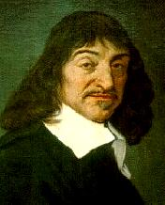
Cartesian Products of Sets
For sets A, B, their Cartesian product 笛卡尔集 A×B :≡ {(a, b) | a∈A ∧ b∈B }.
E.g. {a,b}×{1,2} =
{(a,1),(a,2),(b,1),(b,2)}
René Descartes (1596-1650)
Notes:
Usually AxBxC is defined as {(a,b,c) | a is in A and b is in B and c is in C}.

Slide 23
Cartesian Products of Sets
{John,Mary,Ellen}x{News,Soap}=
{(John,News),(Mary,News), (Ellen,News),(John,Soap),
(Mary,Soap),(Ellen,Soap)}
If R is a relation between A and B then R⊆AxB
Example. R= {(John,News),(Mary,Soap),(Ellen,Soap)}
Notes:
Usually AxBxC is defined as {(a,b,c) | a is in A and b is in B and c is in C}.

Slide 24
Cartesian Products of Sets
Note that
for finite A, B: |A×B| = |A||B|
notation extends naturally to A₁ × A₂ × … × A_{n}
the Cartesian product is not commutative: i.e., ¬∀A∀B: A×B=B×A.
Notes:
Usually AxBxC is defined as {(a,b,c) | a is in A and b is in B and c is in C}.

Slide 25
Using Set Notation with Quantifiers
∀x∈S P(x) denotes the universal quantification
∃x∈S P(x) denotes the existential quantification
∀x∈R (x^2≥0) ?
∃ x∈Z (x^2=1) ?

Slide 26
Set Operations

Slide 27
Start §2.2: The Union Operator
For sets A, B, their union A∪B is the set containing all elements that are either in A, or (“∨”) in B (or, of course, in both).
Formally, ∀A,B: A∪B = {x | x∈A ∨ x∈B}.
∀A ∀ B: (A∪B ⊇ A) ∧ (A∪B ⊇ B)

Slide 28
Union Examples
{a,b,c} ∪ {2,3} = {a,b,c,2,3}
{2,3,5} ∪ {3,5,7} = {2,3,5,3,5,7} ={2,3,5,7}

Slide 29
The Intersection Operator
For sets A, B, their intersection A∩B is the set containing all elements that are simultaneously in A and (“∧”) in B.
Formally, ∀A,B: A∩B={x | x∈A ∧ x∈B}.
∀A ∀ B: (A∩B ⊆ A) ∧ (A∩B ⊆ B)

Slide 30
Intersection Examples
{a,b,c} ∩ {2,3} = ___
{2,4,6} ∩ {3,4,5} = ______
∅
{4}

Slide 31
Disjointness
Two sets A, B are called disjoint (i.e., not joined) iff their intersection is empty. (A∩B=∅)
Example: the set of even integers is disjoint with the set of odd integers.

Slide 32
Inclusion-Exclusion Principle
How many elements are in A∪B? Can you think of a general formula? (Express in terms of |A| and |B| and whatever else you need.)
Notes:
We will see this basic counting principle again when we talk about combinatorics.

Slide 33
Inclusion-Exclusion Principle
How many elements are in A∪B? |A∪B| = |A| + |B| − |A∩B|
Example: How many students are on our class email list? Consider set
E = I ∪ M, I = {s | s turned in an information sheet} M = {s | s sent the TAs their email address}
Some students may have done both! |E| = |I∪M| = |I| + |M| − |I∩M|
Notes:
We will see this basic counting principle again when we talk about combinatorics.

Slide 34
Set Difference
For sets A, B, the difference of A and B, written A−B, is the set of all elements that are in A but not B. Formally: A − B :≡ {x | x∈A ∧ x∉B}
Also called: The complement of B with respect to A.
Notes:
NOT (x in A -> x in B) = NOT (x not in A or x in B) (defn. of implies) = x in A AND x not in B (DeMorgan’s law).

Slide 35
Set Difference Examples
{1,2,3,4,5,6} − {2,3,5,7,9,11} = ___________
Z − N = {… , −1, 0, 1, 2, … } − {0, 1, … } = {x | x is an integer but not a nat. #} = {x | x is a negative integer} = {… , −3, −2, −1}
{1,4,6}

Slide 36
Set Difference - Venn Diagram
A−B is what’s left after B “takes a bite out of A”
Chomp!
Set A−B
Set A
Set B

Slide 37
Set Complements
The universe of discourse can itself be considered a set, call it U.
=U−A.
E.g., If U=N,

Slide 38
Set Identities, Generalized and Intersections

Slide 39
Set Identities
A∪∅ = A = A∩U
A∪U = U A∩∅ = ∅
A∪A = A = A∩A
A∪B = B∪A A∩B = B∩A
A∪(B∪C)=(A∪B)∪C A∩(B∩C)=(A∩B)∩C

Slide 40
(don’t worry about their names)
Identity: A∪∅ = A = A∩U
Domination: A∪U = U , A∩∅ = ∅
Idempotent: A∪A = A = A∩A
Double complement:
Commutative: A∪B = B∪A , A∩B = B∩A
Associative: A∪(B∪C)=(A∪B)∪C , A∩(B∩C)=(A∩B)∩C

Slide 41
DeMorgan’s Law for Sets
Exactly analogous to (and provable from) DeMorgan’s Law for propositions.

Slide 42
Proving Set Identities
How to prove E₁ = E₂ ?(where the Es are set expressions)
Prove E₁ ⊆ E₂ and E₂ ⊆ E₁ separately.
Use set builder notation & logical equivalences.
2. Use a membership table. 少用
Notes:
A membership table is like a truth table.

Slide 43
Method 1: Mutual subsets
Example: Show A∩(B∪C)=(A∩B)∪(A∩C).
Part 1. prove E₁ ⊆ E₂ .
Assume x∈A∩(B∪C), then x∈A, and x∈ B∪C.
⇒ x∈A, and either x∈B or x∈C.
Case 1: x∈B. Then x∈A∩B, so x∈(A∩B)∪(A∩C).
Case 2: x∈C. analogous,
⇒ x∈(A∩B)∪(A∩C).
⇒ A∩(B∪C)⊆(A∩B)∪(A∩C).
Part 2: E₂ ⊆ E₁ . (analogous)

Slide 44
Method 2: Mutual subsets
translate into propositional logic, then reason within propositional logic, then translate back into set theory.
Example: Show A∩(B∪C)=(A∩B)∪(A∩C).
Part 1. prove E₁ ⊆ E₂ .
Assume x∈A∩(B∪C)
⇒ x∈A ∧ (x∈B ∨ x∈C).
⇒ ( x∈A ∧ x∈B) ∨ (x∈A ∧ x∈C).
⇒ ( x∈A ∩ B) ∨ (x∈A ∩ C).
⇒ x∈(A∩B)∪(A∩C).
Part 2: E₂ ⊆ E₁ . (analogous)

Slide 45
Method 3: Membership Tables
Just like truth tables for propositional logic.
Columns for different set expressions.
Rows for all combinations of memberships in constituent sets.
Use “1” to indicate membership in the derived set, “0” for non-membership.
Prove equivalence with identical columns.

Slide 46
Membership Table Example
Prove (A∪B)−B = A−B.
Notes:
There are 4 basic kinds of elements (i.e.,basic regions of the Venn diagram): the ones that are in neither A nor B, the ones that are in B but not A, etc. Everything
analogous to truth tables, but based on the different regions of a Venn diagram.
The proof shows that the two formulas cover the same basic regions of the diagram,
That is, the same kinds of objects.

Slide 47
Membership Table Exercise
Prove (A∪B)−C = (A−C)∪(B−C).

Slide 48
Membership Table Exercise
Prove (A∪B)−C = (A−C)∪(B−C).

Slide 49
Membership Table Exercise
Prove (A∪B)−C = (A−C)∪(B−C).

Slide 50
Membership Table Exercise
Prove (A∪B)−C = (A−C)∪(B−C).

Slide 51
Generalized Union
Binary union operator: A∪B
n-ary union: A∪A₂∪…∪A_{n} :≡ ((…((A₁∪ A₂) ∪…)∪ A_{n}) (grouping & order is irrelevant)
“Big U” notation:
Or for infinite sets of sets:

Slide 52
Generalized Intersection
Binary intersection operator: A∩B
n-ary intersection: A₁∩A₂∩…∩A_{n}≡((…((A₁∩A₂)∩…)∩A_{n}) (grouping & order is irrelevant)
“Big Arch” notation:
Or for infinite sets of sets:

Slide 53
历史上的考题
Prove: A∩ (B-C) = (A ∩ B) -(A∩ C)

Slide 54
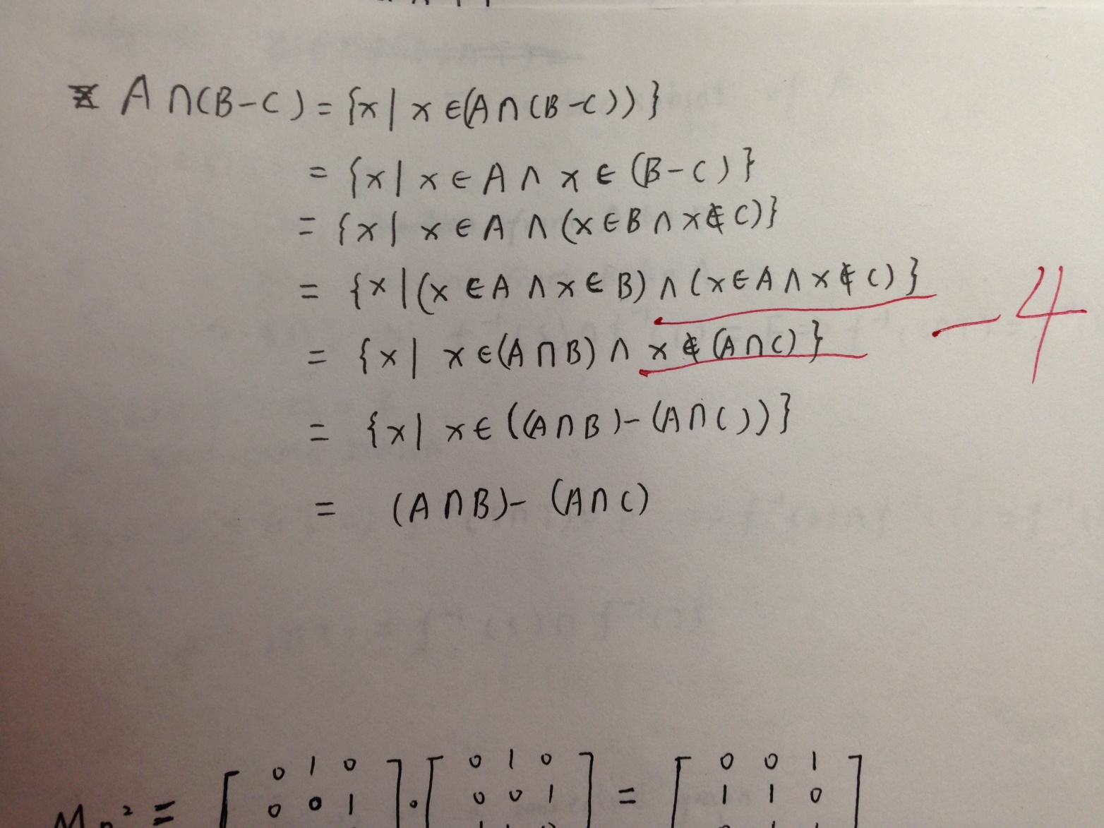

Slide 55
练习
Prove: A∩ (B-C) = (A ∩ B) - (A∩ C)
Proof: first, show A∩ (B-C) ⊆ (A ∩ B) - (A∩ C).
x ∈ A∩ (B-C)
⇒(x ∈ A) ∧ [x ∈ (B-C)]
⇒(x ∈ A) ∧ [(x ∈ B) ∧( x ∉ C)]
⇒[(x ∈ A) ∧ (x ∈ B)] ∧ ( x ∉ C)
⇒[x ∈ A ∩ B] ∧[ x ∉ A ∩ C ] since(A ∩ C⊆C )
⇒x ∈ (A ∩ B) – (A ∩ C) since(the definition of -)

Slide 56
练习
Prove: A∩ (B-C) = (A ∩ B) - (A∩ C)
Proof: second, show A∩ (B-C) ⊇ (A ∩ B) - (A∩ C).
x ∈ (A ∩ B) – (A ∩ C)
⇒[x ∈ A ∩ B] ∧[ x ∉ A ∩ C ]
⇒[(x ∈ A) ∧ (x ∈ B)] ∧ ¬[ x ∈ A ∩ C ]
⇒(x ∈ A) ∧ (x ∈ B) ∧ ¬[ x ∈ A ∧ x ∈ C ]
⇒(x ∈ A) ∧ (x ∈ B) ∧ [ x ∉ A ∨ x ∉ C ]
⇒ (x ∈ B) ∧ [ F ∨ ((x ∈ A) ∧ (x ∉ C)) ]
⇒ (x ∈ B) ∧ (x ∈ A) ∧ (x ∉ C)

Slide 57
练习
Prove: A∩ (B-C) = (A ∩ B) - (A∩ C)
Proof:
x ∈ (A ∩ B) – (A ∩ C)
…….
⇒ (x ∈ B) ∧ (x ∈ A) ∧ (x ∉ C)
⇒ (x ∈ A) ∧ [(x ∈ B) ∧ (x ∉ C)]
⇒ (x ∈ A) ∧[ x ∈ ( B -C)]
⇒ x ∈ A∩ (B-C)

Slide 58
P110 6 14
P120 9

Slide 59
End of the Section 2.1
59

